Slide 1


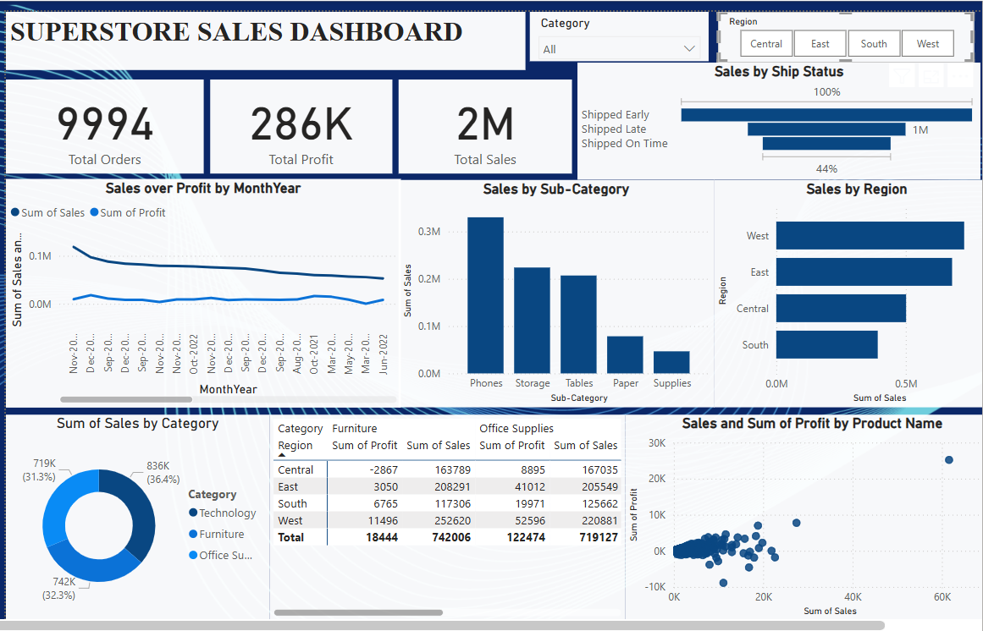
SUPERSTORE SALES DASHBOARD
Name- SANKET SHINDE

Slide 2


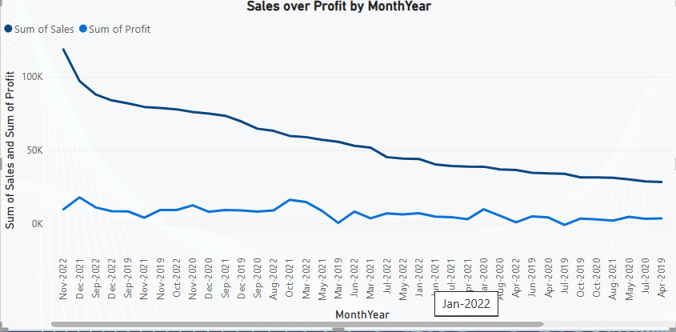
1. Sales Performance Over Time
Sales have shown consistent growth over the last few months, with a peak observed in [Month-Year]. This indicates strong seasonal demand and effective promotional campaigns during that period.

Slide 3
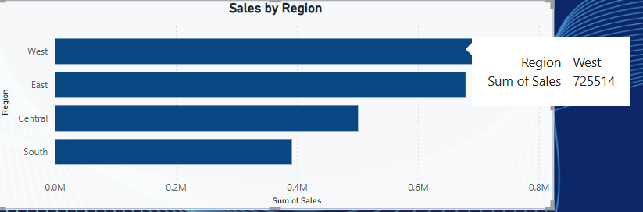
2. Top Performing Region
The [e.g., West] Region contributed the highest revenue, accounting for 725514 of total sales. It outperformed other regions consistently across months.

Slide 4
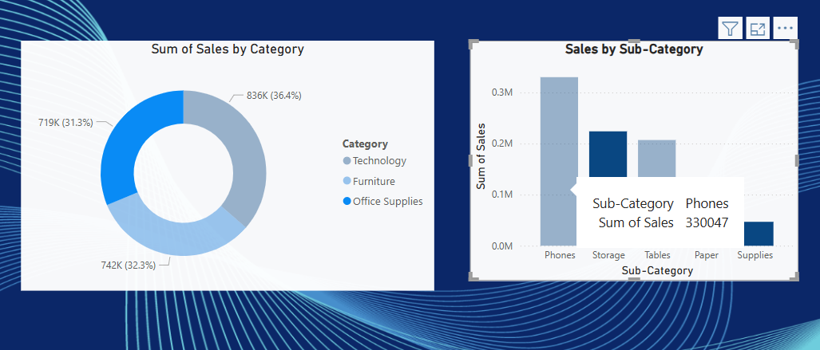
3. Most Profitable Category
The [e.g., Technology] Category generated the highest sales and profit margins. Within this category, [e.g., Office supplies] stood out as the top sub-category.

